Slide 1
Neural Networks
Course 10: Reinforcement Learning. On-policy

Slide 2
Overview
Reinforcement Learning
Off Policy vs On Policy
Gradient Policy Algorithm
Actor Critic
Questions

Slide 3
Reinforcement Learning

Slide 4
Reinforcement Learning: concepts
  Reinforcement learning is learning what to do--how to map situations to actions--so as to maximize a numerical reward signal
  Reinforcement learning has 3 basic components:
    Agent
    Environment
    Actions

Slide 5
Reinforcement Learning: concepts
  An agent has 4 basic components:
    A policy
      The most important. Is the decision making function. Defines what should the agent do in any of the situations it encounters
    A reward function
      Defines the goal of the RL agent. It maps the state of the environment to a single number, a reward, indicating the intrinsic desirability of the state
    A value function
    Defines what is good in the long run. More exactly, the total amount of reward the agent can expect starting from that state
    A model of the environment
      Defines the states as well as the way to transition from one state to another (through actions)

Slide 6

Reinforcement Learning: concepts

Slide 7
Off Policy vs On Policy

Slide 8

Off Policy vs On Policy

Slide 9

Off Policy vs On Policy

Slide 10

Off Policy vs On Policy
Notes:
Un exemplu bun ar fi cand invat sa folosesc un gps. Sa zicem ca nu am directia, dar pot observa ca daca fac 4 pasi in stanga e posibil sa ma deplasez spre vest, 4 pasi spre dreapta ma deplasez spre est si tot asa. Dupa ce am suficiente informatii pot sa-mi dau seama cum sa ajung intr-un punct, chiar daca nu asta a fost scopul initial
La online, exemplu ar fi asa. Vreau sa ajung in punctul a si fac niste pasi intr-o directive. Vad daca ma departez sau nu. Ajustez directia de deplasare si iar fac un pas, mai ajustez si iar fac un pas, scopul ramanand acelasi

Slide 11
Off Policy vs On Policy
    On policy vs Off policy
      Off policy algorithms can update the estimated value functions using hypothetical actions, those which have not actually been tried
      On policy algorithms update the value function strictly based on experience
      The on-policy methods can take into account actions that might bring a very high penalty and adapt accordingly
      The on-policy methods can get stuck in local minimum

Slide 12

Off Policy vs On Policy
    A classic example:
      A mouse has to find the path to its house. It can move N, W, S, E
      Between the mouse and its house there is a cliff.
      If the mouse gets to the cliff, a big reward(penalty) will be received: -100
      For every move he makes he gets a reward (penalty) of -1
      With a probability of 0.1, the mouse makes a random move (in order to explore the environment)

Slide 13
Off Policy vs On Policy
    A classic example:
      The agent using Q-learning finds the optimal policy: it moves along the cliff and gets to the reward.
      However, from time to time (due to exploration ) the mouse falls into the cliff
      The agent using SARSA learning understands that from time to time it performs some random actions and tries to adapt accordingly.
      For this reason, the agent goes several steps away from the cliff and then starts orienting to the target

Slide 14
Gradient Policy Algorithm

Slide 15
Gradient Policy Algorithm
    Until now, we’ve been using an algorithm (Q-learning or SARSA) to decide what are actions will be
    We’ve used neuronal networks to approximate the value function
    However, we can use neural networks to directly learn the right actions the agent needs to take in order to increase the total reward
    We’ll use the car example from the previous class

Slide 16
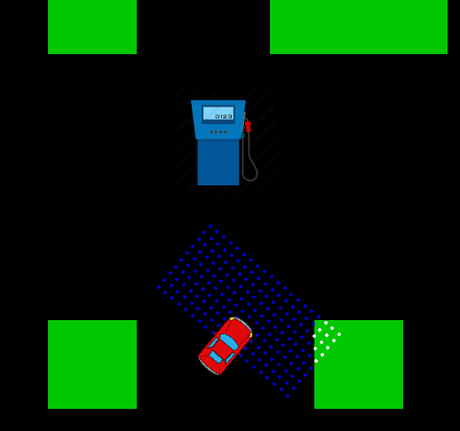
Example
Example: Train a car to avoid obstacles and reach to the gas station
States: the car only knows what is in front and on its side.
It does that through 20 sensors that each can detect an object that is at most 10 units away
(it does not know where the gas station is) or how the map looks like
(This is more realistic)

Slide 17
Example
Actions:
The car always moves. It can, however, decide to move left , right or do nothing (move forward)

Slide 18
Gradient Policy Algorithm
    Until now, we’ve been using an algorithm (Q-learning or SARSA) to decide what are actions will be
    We’ve used neuronal networks to approximate the value function
    However, we can use neural networks to directly learn the right actions the agent needs to take in order to increase the total reward
    For this, we’ll use the Policy Gradient Algorithm

Slide 19
Gradient Policy Algorithm
    Gradient Policy Advantages:
Policy Based Methods have better convergence. We’re just computing the gradient to say how we can can increase the score. We don’t have to explore that much
Works better in high dimensional action spaces. For example when you don’t have a fixed set of actions, but a value that you have to output
Can learn Stochastic policies:
  We don’t need to implement an exploration vs exploitation strategy (i.e. 𝜺- greedy strategy)
Disadvantages:
It finds the local maximum instead of the global one
Notes:
Better convergence since

Slide 20



Gradient Policy Algorithm
    We’ll define a policy network that defines the agent (i.e. car)
    The network will take the state of the agent (i.e. 10 sensors) and will output which state is the most probable one.
    We will train the network using gradient descent in order to maximize the reward
    So the reward function will act similar to our cost function
Network – hidden layers
state
Notes:
Observe that our network outputs an action based on the state. So we’ll consider this to be the policy function

Slide 21
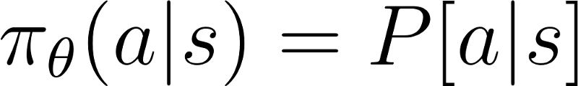
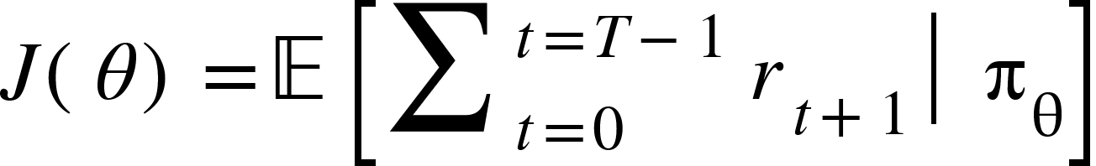
Gradient Policy Algorithm
We need to define our Reward function based on the policy. Such that an update on the neural network (policy) will result in an increase of the reward.
Our policy (based on the neural network(𝜃) is defined as below
Based on the policy, we can define our value function, that we want to maximize
Notes:
Vorbim de cazuri episodice, de exemplu cand avem un joc. Acolo trebuie sa maximizam Value function pornind din starea initiala

Slide 22
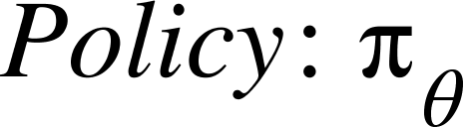
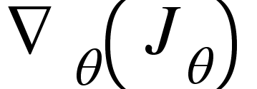
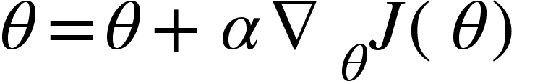
Gradient Policy Algorithm
Having a full episode starting from the first state, and following our policy
We compute the objective function
We compute the gradient of the Objective function w.r.t. 𝜃
We update the network weights, to increase the value of the Objective function:
Notes:
Vorbim de cazuri episodice, de exemplu cand avem un joc. Acolo trebuie sa maximizam Value function pornind din starea initiala

Slide 23
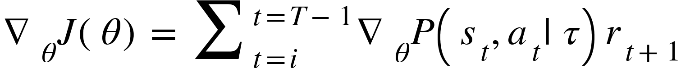
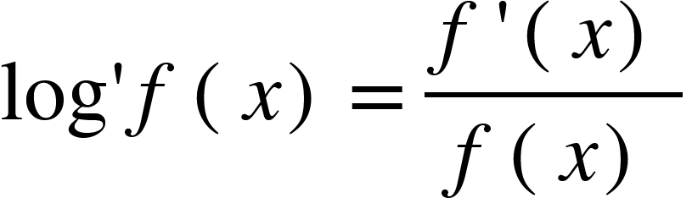
Gradient Policy Algorithm
The hardest part is to understand how we obtain the gradient:
We first expand the expectation:
We differentiate w.r.t 𝜃
      We use the following observation:
Notes:
Where i is an arbitrary starting point in the trajectory,
P(st, at) is the probability of encounting st and at along th
By definition, the expectation of any function $f\left(τ\right)$ under a distribution $p\left(τ\right)$ is:
$$𝔼_{τ}\left[f\left(τ\right)\right]=\sum_{τ}{p}\left(τ\right) f\left(τ\right)$$
Formual de expectation e aplucata pe o traiectorie, dar media e facuta pe mai multe traiectorii
Deci, daca o traiectorie conform politicii noastre (reteaua), Value function este data de media (aici lipsteste) P(st,at|t)* reward-ul pe care-l obtii (asta nu mai e probabilistic. E dat de env)

Slide 24
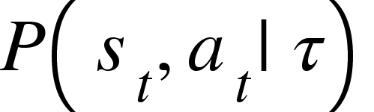
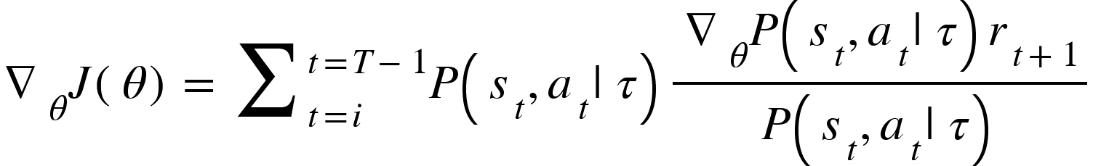
Gradient Policy Algorithm
we multiply and divide by
We replace with the logarithm based on the previous observation
      We transform it to expectation
  During training, we’ll take samples of episodes, so we’ll just approximate the gradient by the sum.
Notes:
Where i is an arbitrary starting point in the trajectory,
P(st, at) is the probability of encounting st and at along th

Slide 25
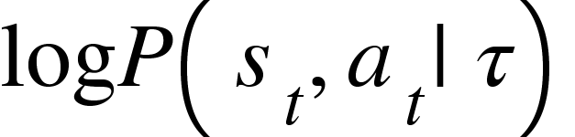
Gradient Policy Algorithm
We’ll analyze in more detail
Transform it into a sum
Differentiate wrt to 𝜃
This first sum is dependent on the environment, not on the agent. So we get:
Notes:
Practic, desfac traiectoria data de reteaua mea.

Slide 26
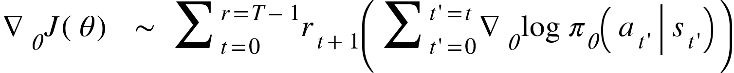

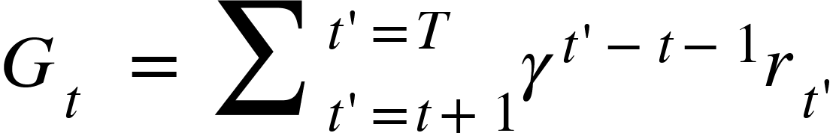
Gradient Policy Algorithm
Replacing this in our Reward function
This can also be noted as follows:
In case future rewards are discounted, we can arrive at a similar formula,
Notes:
E doar notatie matematica
$$r_{1}\left(g_{0}\right)+r_{2}\left(g_{0}+g_{1}\right)+r_{3}\left(g_{0}+g_{1}+g_{2}\right)=r_{1}g_{0}+r_{2}g_{0}+r_{2}g_{1}+r_{3}g_{0}+r_{3}g_{1}+r_{3}g_{2}=g_{0}\left(r_{1}+r_{2}+r_{3}\right)+g_{1}\left(r_{2}+r3\right)+g_{2}(r_{3})$$

Slide 27

Gradient Policy Algorithm
So, the formula for the gradient of the reward function wrt to the policy is:
where

Slide 28
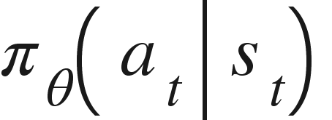
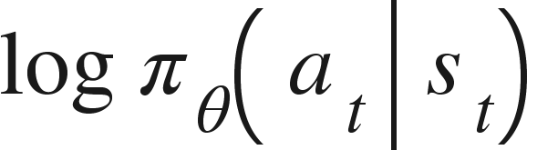
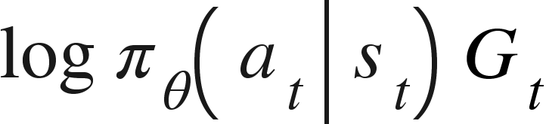
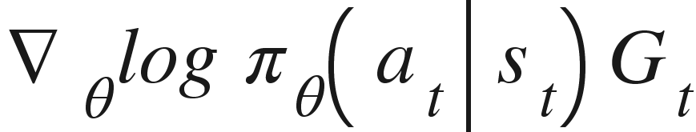
Gradient Policy Algorithm
This tells us that, in order to train the network to choose an action that will maximize the reward we have to, at each time step
  Choose an action according to our policy:
  Compute the log of the probability of the action that was chosen
  Compute the discounted future return and multiply it by the log value.
  The problem here is that we only know this when the episode ends
  Compute the gradient of this value w.r.t to each weight in the network:
Notes:
Where i is an arbitrary starting point in the trajectory,
P(st, at) is the probability of encounting st and at along th

Slide 29
Gradient Policy Algorithm: detailed steps
Initialize the network
  Our network we’ll receive as input the the current environment state
  Since we want to be stochastic, we’ll use a SoftMax layer as the final layer
  The weights are initialized randomly, depending on the activation function
Softmax
Network – hidden layers
state
Notes:
Observe that our network outputs an action based on the state. So we’ll consider this to be the policy function

Slide 30
Gradient Policy Algorithm:detailed steps
Generate episodes
  For each episode:
    We will feed the state of the agent to the neural network at each time - step (just like in q-learning)
    After the feed-forward step we will choose an action in a stochastic way, based on the softmax layer:
      I.e. if we have 3 actions with the probabilities: 0.1, 0.3, 0.6, we’ll generate a random number between 0 and 1 and choose the action based on the interval it is in
    Compute the action, move into a new state and get the reward.
Notes:
Where i is an arbitrary starting point in the trajectory,
P(st, at) is the probability of encounting st and at along th
We need to remember this reward since we’ll be using it to obtain the discounted reward

Slide 31
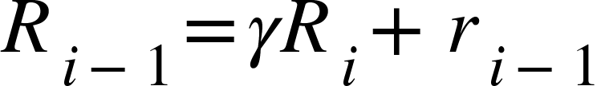
Gradient Policy Algorithm:detailed steps
Compute the reward:
In most of the cases, the reward can only be computed at the end of the episode.
When an episode finishes, we’ll compute the discounted rewards for every state (from the final state to the initial one):
Notes:
Where i is an arbitrary starting point in the trajectory,
P(st, at) is the probability of encounting st and at along th
We need to remember this reward since we’ll be using it to obtain the discounted reward

Slide 32
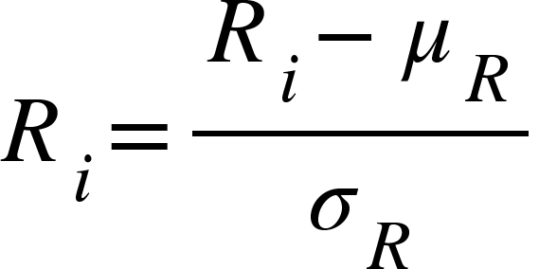

Gradient Policy Algorithm:detailed steps
Compute the reward:
Since there might be very long episodes and the reward is computed at the end, it is possible to have a big variance in the rewards
One way to solve this is to standardize the results (i.e. z-score). This way we’ll increase the probability of better than average results and decrease the probability of the others.
Notes:
Where i is an arbitrary starting point in the trajectory,
P(st, at) is the probability of encounting st and at along th
We need to remember this reward since we’ll be using it to obtain the discounted reward

Slide 33
Gradient Policy Algorithm:detailed steps
Compute the gradient
  For every time-step from the completed episode:
    We compute the log of the probability of the action we have chosen
    Multiply the value by the previously computed future discounted reward
    Perform backpropagation to obtain the gradient in respect to each weight
Notes:
Where i is an arbitrary starting point in the trajectory,
P(st, at) is the probability of encounting st and at along th
We need to remember this reward since we’ll be using it to obtain the discounted reward

Slide 34
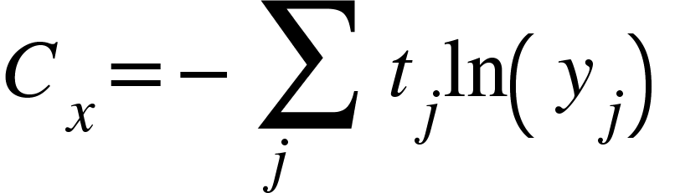
Gradient Policy Algorithm:detailed steps
Compute the gradient
  Some neural network frameworks allow to obtain the gradient automatically, while others expect a loss function.
  Transforming the computation of the gradient into a loss function:
    If you remember from the 4th course, the formula for cross-entropy, for a multilabel network:
Notes:
Where i is an arbitrary starting point in the trajectory,
P(st, at) is the probability of encounting st and at along th
We need to remember this reward since we’ll be using it to obtain the discounted reward

Slide 35
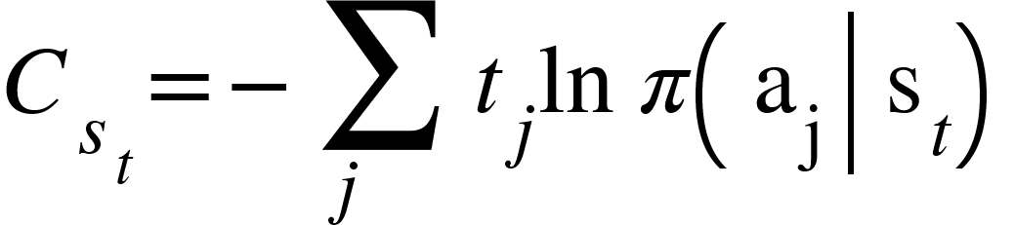
Gradient Policy Algorithm:detailed steps
Compute the gradient
  Written in term of probabilities, as our gradient, the cost gets:
  So, in order to compute the gradients required by the policy gradient algorithm,
    use the categorical cross entropy function, as the loss function
    Create a target vector of the type one-hot, and set the t_{j}=G_{t}
Notes:
Precizeaza aici ca e cu - pentru ca e functie de loss, dar a face loss
So we;re training like supervised training but with a chaning dataset.

Slide 36
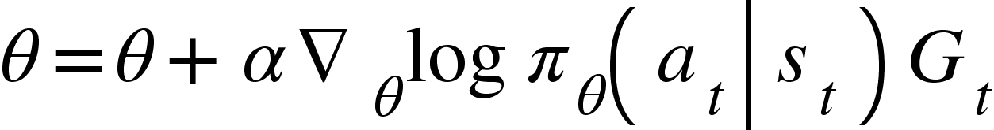
Gradient Policy Algorithm:detailed steps
Adjust the weights
  Using a neural network framework (such as pytorch), this is done automatically. We just have to provide the input (s_{t} )the target (G_{t} ).
  The update must be performed at the end of one or multiple episodes. Not during the episode. We’re performing an off-policy update of an on-policy algorithm
  If the gradients were computed separate, not part of an automated training process, the update is:
Notes:
Precizeaza aici ca e cu - pentru ca e functie de loss, dar a face loss

Slide 37
Actor Critic

Slide 38
Actor Critic
  Current reinforcement algorithms presented:
Q-learning:
  learns to predict a score for each action, value pair. Based on it we can choose the optimal policy
    each small improvement in the Q function translates into an improvement of the policy → training is faster
Policy Gradient:
  it’s stochastic and learns what it’s the action that will most probably improve the overall reward.
    learning the policy is usually simpler than the Q functions.

Slide 39
Actor Critic
Some disadvantages of policy gradient:
  We need a full episode in order to get the discounted result. This slows down the learning
  There are cases when the reward at the end of the episode is very big. This final big reward, discounted at each previous step, will make all the previous decisions as either bad or good
a₁
a₁
a₂
a₁
a₁
a₂
R
s₁
s₂
s₃
s₃
s₄
s₅
s₁
actian a₁ taken at state s₃ was a bad action but was labeled as good due to a final good reward
Notes:
It would be usefull if these could be labeled separatly

Slide 40
Actor Critic
Actor Critic tries to bring advantages from both worlds
  It is made of two parts: actor + critic
  Actor:
    A policy gradient algorithm: improves its policy in order to maximize the predicted rewards
  Critic:
    Evaluates each state and action and predicts the final reward
  Both the actor and the critic are implemented using neural networks
Notes:
It would be usefull if these could be labeled separatly,

Slide 41
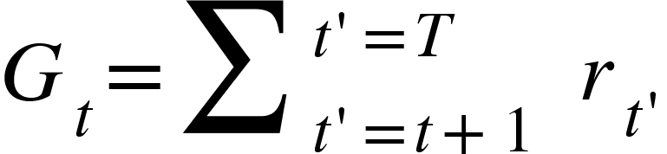
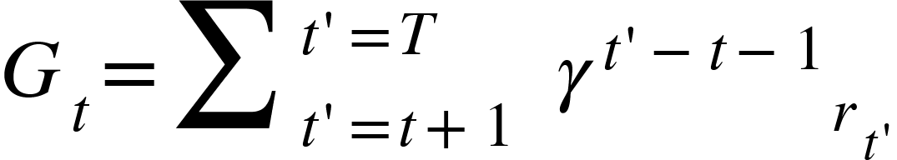
Actor Critic
Q-Actor Critic
  Formula used for policy gradient algorithm
  G_{t} is actually de Q(s,a) function.
or
future rewards
discounted future rewards

Slide 42
Actor Critic
Q-Actor Critic
  We can introduce the Q(s,a) into the policy gradient algorithm
  We know we can have a neural network that can learn to approximate the Q(s,a) function
Notes:
Aici w este folosit pentru a arata ca Q_w este aproximat

Slide 43
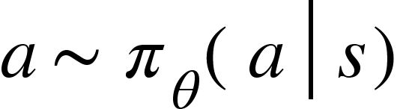
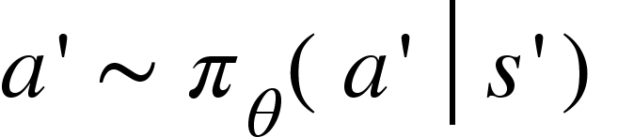
Actor Critic
Training pseudocode:
  Initialize neural network for Actor (similar to policy gradient algorithm): 𝜃
  Initialize neural network for Critic (similar to Q-learning algorithm): w
  Generate Episodes:
Use actor to sample an action for the initial state
    For t = 1 .. T do:
      Perform the action, get the reward r_{t} and the next state s’
      Use Actor to sample an action for the next state
      Update the actor network
      Update the critic network
      a=a’ and s=s’
Notes:
Aici w este folosit pentru a arata ca Q_w este aproximat

Slide 44
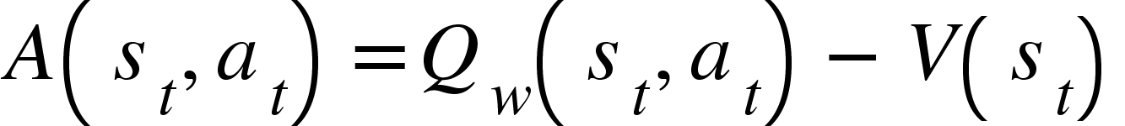
Actor Critic
Advantage-Actor Critic
  Similar to Q-critic, but instead of multiplying by Q_{w}(s,a) we multiply the gradient by an advantage function:
  So, the gradient becomes:

Slide 45
Actor Critic
Advantage-Actor Critic
  The idea of the advantage is to compute how much better is to take a specific action at a given state compared to the what is believed to be the best so far.
  The problem with this approach is that we don’t know how to approximate V(s_{t}) . We could do it with a neural network, but that brings unnecessary overhead

Slide 46
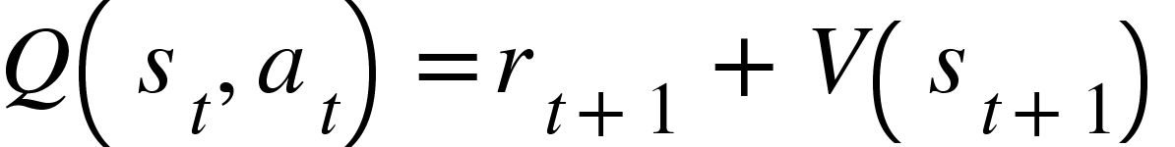
Actor Critic
Advantage-Actor Critic
  However, we can write the Q function using the V function:
  So, the advantage function becomes:
  So, we can use only one neural network, that will approximate V in order to compute the advantage.

Slide 47
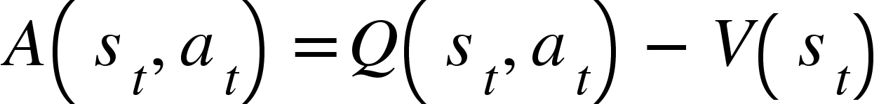
Actor Critic
Depending on how we perform the updates, there can be two variations of the advantage actor critic network:
  on-policy update: we perform the update after each step:
  This is similar to the Q-Actor Critic. This has the advantage of a low variance of the rewards, but is biased on the current policy:
  off-policy update: we wait until the episode finishes and perform the update for each visited state.
  This is similar to the policy gradient algorithm. In this case we can compute the correct values of the Q(s,a) to compute the advantage.

Slide 48
Gradient Policy Algorithm: detailed steps
Advantage Actor Critic:
  Training the Network that will output the Value state
    Input layer is the state of the agent
    Output is a scalar, the V(s) function
  Since this is a regression problem, MSE function will be used for the cost function
linear
V(s)
Network – hidden layers
state
Notes:
No matter the variation, we still need the prediction of the value function

Slide 49


Gradient Policy Algorithm: detailed steps
Advantage Actor Critic: on-policy update
  In this scenario, we will update the network after each time step
  Store the predicted V(s_{t} ) for the current state
  Perform a step according to the Actor Network , receive reward r_{t} and get new state: s_{t+1}
  Predict V(s_{t+1})
  Update the network using input: s_{t} and the target $r_{t}+γV(s_{t+1})$
linear
V(s_{t +1}) + r_{t}
$$V\left(s_{t}\right)=r_{t}+γV(s_{t+1})$$
Network – hidden layers
s_{t}
Notes:
Similar to how we train the q(s,a) network

Slide 50
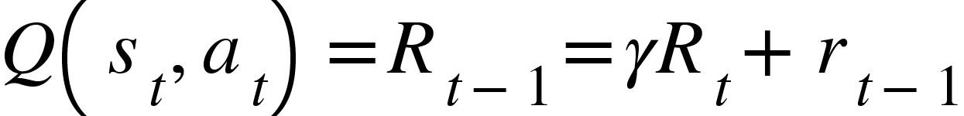
Gradient Policy Algorithm: detailed steps
Advantage Actor Critic: off-policy update
  In this scenario, we will update the network at the end of the episode
  For each time step , store the s_{t} , r_{t} and the predicted V(s_{t} )
  After the episode is finished, go backward and compute the discounted reward, at each timestep
  Update the network using input: s_{t} and the target Q(s_{t},a_{t})
linear
Q(s_{t} )
real discounted reward
Network – hidden layers
s_{t}
Notes:
V(st) will actually be used to compute the advantage

Slide 51
Implementation

Slide 52
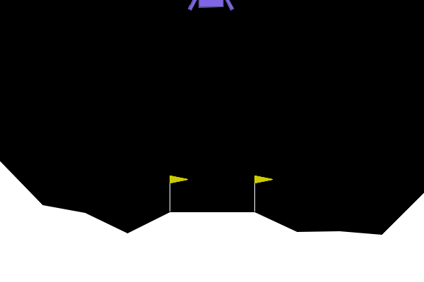
Implementation
Lunar Lander environment:
Action Space
There are four discrete actions available:
0: do nothing
1: fire left orientation engine
2: fire main engine
3: fire right orientation engine
Observation Space
The state is an 8-dimensional vector:
the coordinates of the lander in x & y,
its linear velocities in x& y,
its angle,
its angular velocity,
two booleans that represent whether each leg is in contact with the ground or not.
image & text from: https://gymnasium.farama.org/environments/box2d/lunar_lander/

Slide 53
Implementation
Lunar Lander environment:
Rewards
After every step a reward is granted. The total reward of an episode is the sum of the rewards for all the steps within that episode.
For each step, the reward:
is increased/decreased the closer/further the lander is to the landing pad.
is increased/decreased the slower/faster the lander is moving.
is decreased the more the lander is tilted (angle not horizontal).
is increased by 10 points for each leg that is in contact with the ground.
is decreased by 0.03 points each frame a side engine is firing.
is decreased by 0.3 points each frame the main engine is firing.
The episode receives an additional reward of -100 or +100 points for crashing or landing safely respectively.
An episode is considered a solution if it scores at least 200 points
The episode finishes if:
the lander crashes (the lander body gets in contact with the moon);
the lander gets outside of the viewport (x coordinate is greater than 1);
text from: https://gymnasium.farama.org/environments/box2d/lunar_lander/

Slide 54
Implementation
Create imports for training the lunar lander.
Gymanasium package provides the environment for training the lunar lander
torch.distributions.Categorical is used to choose an action based on a set of probabilities
Ex.
Define the necessary imports
import os
import torch
import torch.nn as nn
import torch.optim as optim
import torch.nn.functional as F
import gymnasium as gym
from torch.distributions import Categorical
import math
probs = torch.tensor([0.2, 0.7, 0.05, 0.05])
m = Categorical(probs)
m.sample()
m.sample()
m.sample()
m.sample()
m.sample()
m.sample()
Output
tensor(1) tensor(1) tensor(0) tensor(0) tensor(1) tensor(1)
code from:
https://medium.com/@dixitaniket76/advantage-actor-critic-a2c-algorithm-explained-and-implemented-in-pytorch-dc3354b60b50

Slide 55
Implementation
Define the actor network
# Actor Network
class Actor(nn.Module):
def __init__(self, input_size, num_actions):
super(Actor, self).__init__()
self.fc1 = nn.Linear(input_size, 64)
self.fc2 = nn.Linear(64, num_actions)
def forward(self, x):
x = F.relu(self.fc1(x))
x = F.softmax(self.fc2(x), dim=-1)
return x
Define a simple network for Actor Network:
1 layer that receives the state ( 8 units ) and sends them to a 64 units hidden layer with ReLU activation
1 output layer of num_actions (4) with softmax activation
code from:
https://medium.com/@dixitaniket76/advantage-actor-critic-a2c-algorithm-explained-and-implemented-in-pytorch-dc3354b60b50

Slide 56
Implementation
Define the critic network
Define a simple network for Critic Network:
1 layer that receives the state ( 8 units ) and sends them to a 64 units hidden layer with ReLU activation
1 output layer responsible of outputing a scalar value
# Critic Network
class Critic(nn.Module):
def __init__(self, input_size):
super(Critic, self).__init__()
self.fc1 = nn.Linear(input_size, 64)
self.fc2 = nn.Linear(64, 1)
def forward(self, x):
x = F.relu(self.fc1(x))
x = self.fc2(x)
return x
code from:
https://medium.com/@dixitaniket76/advantage-actor-critic-a2c-algorithm-explained-and-implemented-in-pytorch-dc3354b60b50

Slide 57
Implementation
Define the actor critic method that will train the actor and the critic networks
def actor_critic(actor, critic, max_steps=2000, gamma=0.99, lr_actor=1e-3, lr_critic=1e-3):
optimizer_actor = optim.Adam(actor.parameters(), lr=lr_actor)
optimizer_critic = optim.Adam(critic.parameters(), lr=lr_critic)
env = gym.make('LunarLander-v3',)
last_20_scores = torch.zeros(20)
episode = 0
Define the actor_critic method that receives: the actor and critic model as well as some parameters for the optimizer (gamma and lr ).
Initialize the environment. This will not show the window, thus will make the training faster.
last_20_scores is used for the stopping condition. Other choice for stopping could have been used, like a nr of iterations.
code from: https://medium.com/@dixitaniket76/advantage-actor-critic-a2c-algorithm-explained-and-implemented-in-pytorch-dc3354b60b50

Slide 58
Implementation
Define the necessary imports
def actor_critic(actor, critic, max_steps=2000, gamma=0.99, lr_actor=1e-3, lr_critic=1e-3):
. . .
while torch.min(last_20_scores) <200:
episode+=1
state = env.reset()[0]
ep_return = 0
done = False
step_count = 0
Define the stopping condition: no episode less than 200 in the last 20 episodes
Initialize some variables that we will update during training:
ep_return: the entire reward value across an episode
done : if the episode is finished
step_count : nr of steps
episode : current episode count
code from: https://medium.com/@dixitaniket76/advantage-actor-critic-a2c-algorithm-explained-and-implemented-in-pytorch-dc3354b60b50

Slide 59
Implementation
def actor_critic(actor, critic, max_steps=2000, gamma=0.99, lr_actor=1e-3, lr_critic=1e-3):
. . .
while torch.min(last_20_scores) <200:
. . .
while not done and step_count < max_steps:
state_tensor = torch.tensor(state, dtype=torch.float32)
# Actor selects action
action_probs = actor(state_tensor)
dist = Categorical(action_probs)
action = dist.sample()
# Take action and observe next state and reward
next_state, reward, done, _,_ = env.step(action.item())
Convert the state to a tensor.
Send the state to the actor model and the probabilities of each action given the state.
Sample an action based on the probabilities.
Take the action and observe the next_state, the immediate reward, if the episode if finished (done). Step also returns other info like if the episode was truncated or other debug information , but these are skipped: (https://gymnasium.farama.org/api/env/#gymnasium.Env.step)
code from: https://medium.com/@dixitaniket76/advantage-actor-critic-a2c-algorithm-explained-and-implemented-in-pytorch-dc3354b60b50

Slide 60
Implementation
def actor_critic(actor, critic, max_steps=2000, gamma=0.99, lr_actor=1e-3, lr_critic=1e-3):
. . .
while torch.min(last_20_scores) <200:
. . .
while not done and step_count < max_steps:
. . .
#add distance as penalty:
x= next_state[0]
y= next_state[1]
#bmr
train_penalty = y*y
train_penalty += x*x
train_penalty += step_count*0.1
reward -= train_penalty
Add a penalty to the reward in order to improve training. The reward will pe penalized by how far the ship is from the landing zone (0,0). A penalty is also added that is directly proportional to the number of steps.
code from: https://medium.com/@dixitaniket76/advantage-actor-critic-a2c-algorithm-explained-and-implemented-in-pytorch-dc3354b60b50

Slide 61
Implementation
def actor_critic(actor, critic, max_steps=2000, gamma=0.99, lr_actor=1e-3, lr_critic=1e-3):
. . .
while torch.min(last_20_scores) <200:
. . .
while not done and step_count < max_steps:
. . .
# Critic estimates value function
value = critic(state_tensor)
next_value = critic(torch.FloatTensor(next_state))
# Calculate TD target and Advantage
td_target = reward + gamma * next_value * (1 - done)
advantage = td_target - value
Use the critic to evaluate the current state and the next state.
Compute the value based on the current reward and the value of the next state, discounted by gamma.
Compute the advantage between the future state and the current state.
code from: https://medium.com/@dixitaniket76/advantage-actor-critic-a2c-algorithm-explained-and-implemented-in-pytorch-dc3354b60b50

Slide 62
Implementation
def actor_critic(actor, critic, max_steps=2000, gamma=0.99, lr_actor=1e-3, lr_critic=1e-3):
. . .
while torch.min(last_20_scores) <200:
. . .
while not done and step_count < max_steps:
. . .
# Critic update with MSE loss
critic_loss = F.mse_loss(value, td_target.detach())
optimizer_critic.zero_grad()
critic_loss.backward()
optimizer_critic.step()
Update the Critic network that evaluates the value of the current state. Compute the loss between the output (value) at the current state and the value based on the next state and the immediate received reward.
Update the weights of the networks.
td_target is computed based on next_value which is the output of the critic network. We just want a value for the loss, we do not want gradients to flow through the network that computed the next_value. .detach returns the tensor , but detached from computation graph. Doesn’t require a gradient.
code from: https://medium.com/@dixitaniket76/advantage-actor-critic-a2c-algorithm-explained-and-implemented-in-pytorch-dc3354b60b50

Slide 63
Implementation
def actor_critic(actor, critic, max_steps=2000, gamma=0.99, lr_actor=1e-3, lr_critic=1e-3):
. . .
while torch.min(last_20_scores) <200:
. . .
while not done and step_count < max_steps:
. . .
# Actor update
log_prob = dist.log_prob(action)
actor_loss = -log_prob * advantage.detach()
optimizer_actor.zero_grad()
actor_loss.backward()
optimizer_actor.step()
Update the Actor network. This is being performed using the derived formulas for the advantage actor critic.
Compute the log of the prob. of the action that was taken. This is equivalent to calling torch.log(action_probs[action]
Multiply by the advantage computed. This is equiavalent to computing rewards in the future
Use this product as a loss function (use a minus to minimize)
Perform backpropagation and update weights
code from: https://medium.com/@dixitaniket76/advantage-actor-critic-a2c-algorithm-explained-and-implemented-in-pytorch-dc3354b60b50

Slide 64
Implementation
def actor_critic(actor, critic, max_steps=2000, gamma=0.99, lr_actor=1e-3, lr_critic=1e-3):
. . .
while torch.min(last_20_scores) <200:
. . .
while not done and step_count < max_steps:
. . .
# Update state, episode return, and step count
state = next_state
ep_return += (reward +train_penalty)
step_count += 1
# Add the score to the last 20 scores
last_20_scores = torch.cat((last_20_scores[1:],torch.tensor(ep_return).unsqueeze(dim=0)))
# training is finished. Close the environment
env.close()
Move to the next state.
Add the reward to the total episode return. The train_penalty is added here just so we can compare to the the ep_return required by the framework. We’ve substracted the penalty before computing the loss, so we’re adding here to cancel that.
Update the total step_count. (This is used in the loss).
Add the episode reward to the queue of last 20 episode rewards and remove the oldest one.
code from: https://medium.com/@dixitaniket76/advantage-actor-critic-a2c-algorithm-explained-and-implemented-in-pytorch-dc3354b60b50

Slide 65
Implementation
def test_trained_agent(actor):
# Test the trained agent in human mode
env = gym.make('LunarLander-v3',render_mode='human')
state = env.reset()[0]
done = False
total_reward = 0
max_steps = 2000 # Maximum steps per episode for testing
Define the method to test the agent.
Initialize the environment in human mode. This will show the interface.
Get an initial state
Initialize variables that will be used during episode generation:
* done : to decide if the episode has finished
* total_reward : to output the total reward during episode
* max_stepts: the maximum number of steps after which to termine an episode.
code from: https://medium.com/@dixitaniket76/advantage-actor-critic-a2c-algorithm-explained-and-implemented-in-pytorch-dc3354b60b50

Slide 66
Implementation
def test_trained_agent(actor):
. . .
while not done:
env.render()
state_tensor = torch.FloatTensor(state)
action_probs = actor(state_tensor)
action = torch.argmax(action_probs).item()
state, reward, done, truncated,info = env.step(action)
total_reward += reward
if total_reward >= max_steps or done:
break
print(f"Total reward in human mode: {total_reward}")
While the episode has not finished:
Render the environment
Send the state to the actor and get the probabilities for each action, given the state
Get the action with the highest probability
Move to next state and get reward
Compute total reward for this episode
If exceeded max nr of steps, break the loop
code from: https://medium.com/@dixitaniket76/advantage-actor-critic-a2c-algorithm-explained-and-implemented-in-pytorch-dc3354b60b50

Slide 67
Questions & Discussion

Slide 68
References
http://www2.econ.iastate.edu/tesfatsi/RLUsersGuide.ICAC2005.pdf
https://www.nervanasys.com/demystifying-deep-reinforcement-learning/
https://gym.openai.com
http://karpathy.github.io/2016/05/31/rl/
https://towardsdatascience.com/understanding-actor-critic-methods-931b97b6df3f
https://towardsdatascience.com/policy-gradient-methods-104c783251e0
https://www.freecodecamp.org/news/an-intro-to-advantage-actor-critic-methods-lets-play-sonic-the-hedgehog-86d6240171d/

